Slide 1
Bell Work
Let’s jump right into homework from last time, and your new material today. We have two ‘review’ sections to get through.

Slide 2
From Last Time…
Page 146 #25, 29, 43, 47, 57, 97

Slide 3
Pre-calc trig
Day 15

Slide 4
2.3 Polynomial and Synthetic Division
Objective: To understand (but potentially never use) synthetic division to find zeros and remainders
2.4 Complex Numbers
Objective: To add, subtract, multiply and divide complex numbers as well as find complex solutions (non-real zeros)

Slide 5
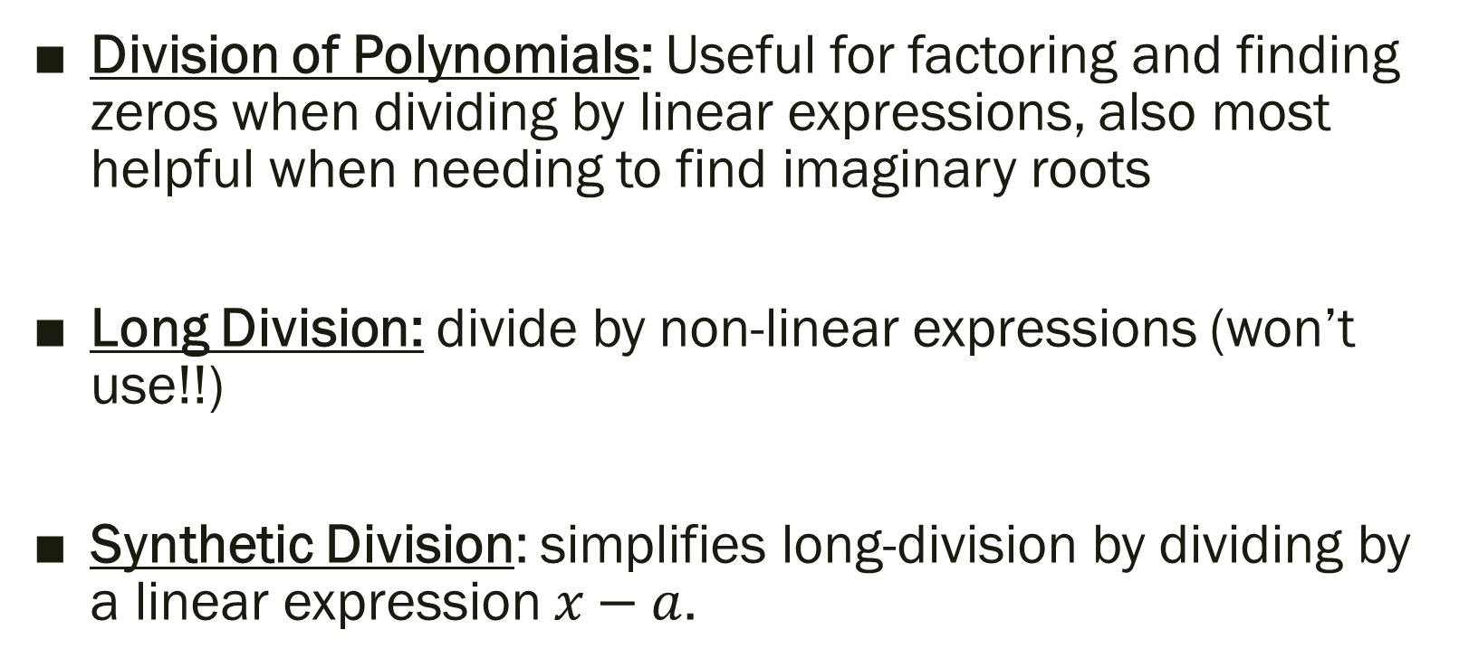
Why do we need to know Synthetic Division exists?
Division of Polynomials: Useful for factoring and finding zeros when dividing by linear expressions, also most helpful when needing to find imaginary roots
Long Division: divide by non-linear expressions (won’t use!!)
Synthetic Division: simplifies long-division by dividing by a linear expression $x−a$.

Slide 6
Synthetic Division Review
When dividing a polynomial by an expression of the form x – a, you can use synthetic substitution as a form of synthetic division.
The final constants equal the coefficients of the quotient
Exponents for the quotient = exponent from original – 1
(for each column)
*if the last column equals 0 then x – a is a factor

Slide 7
Steps to Synthetic Division
Write the equation in standard form
(put 0’s in for exponents not represented)
Multiply leading coefficient by the value of the variable
Sum the next coefficient with the answer from Step 2
Multiply the answer from Step 3 by the value of the variable
Sum the next coefficient with the answer from Step 4
Continue until each coefficient has been used

Slide 8
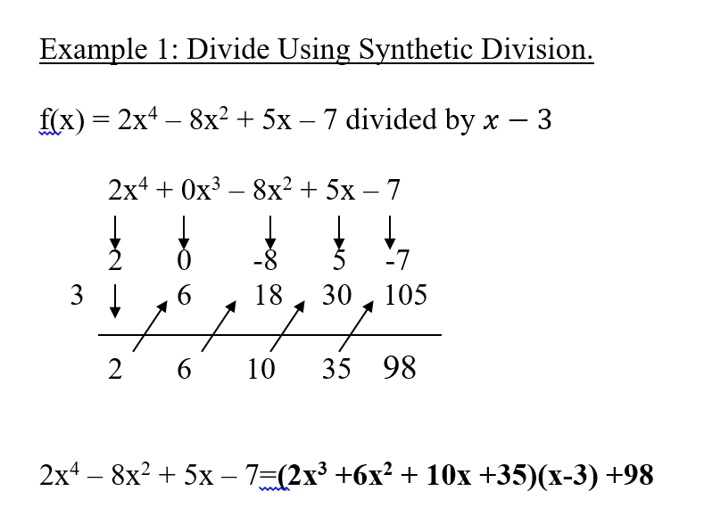
Synthetic Example
Side Note: Remainder Theorem;
If a polynomial f(x) is divided by x – k, then the remainder is
r = f(k)
i.e. in this problem, the remainder is 98 and f(3) = 98

Slide 9
What are complex numbers?
Point of Emphasis:
Complex answers come in pairs, don’t touch x-axis when graphed, and you can use synthetic division with real solutions until you reach a quadratic in which you can use the Quadratic Formula to find complex roots when needed

Slide 10
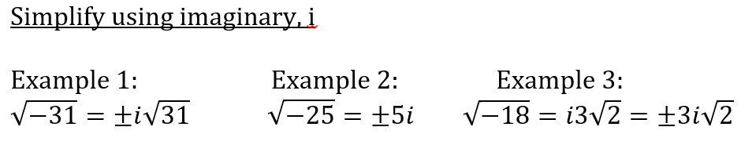
Quick Review of imaginary numbers…
Imaginary Unit: i, defined as
, or, i² = -1

Slide 11
For next time…
Pg 157 #55, 59, 61, 67, 69, 75
Pg 146 #48, 51
More so for discussion next time…
Pg 164 #21, 31, 51, 69, 97

Slide 12
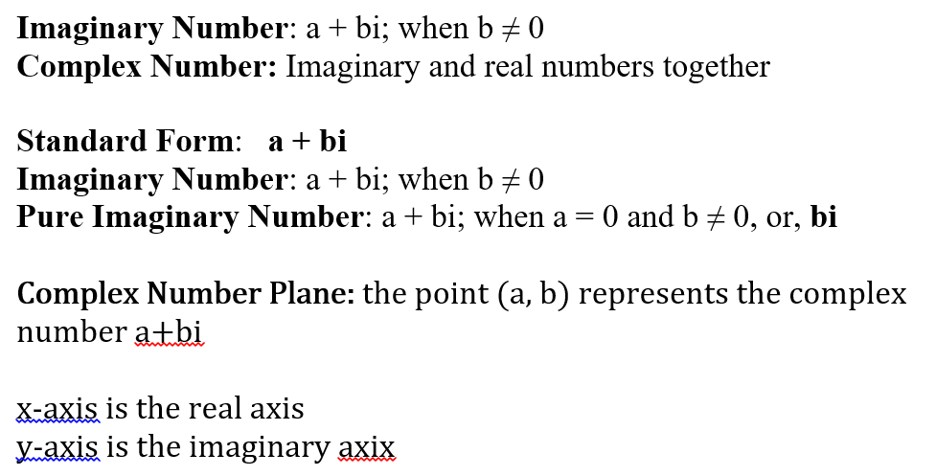
Additional Info on Complex Numbers

Slide 13
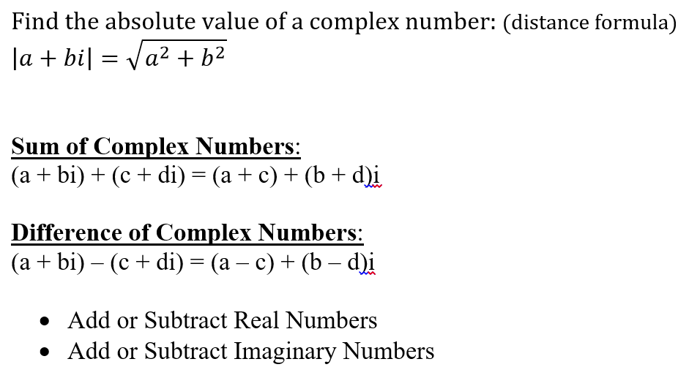
Additional Info on Complex Numbers

Slide 14
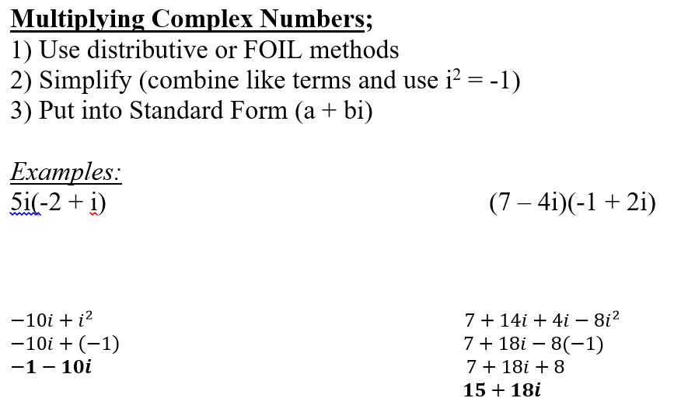
Additional Info on Complex Numbers

Slide 15
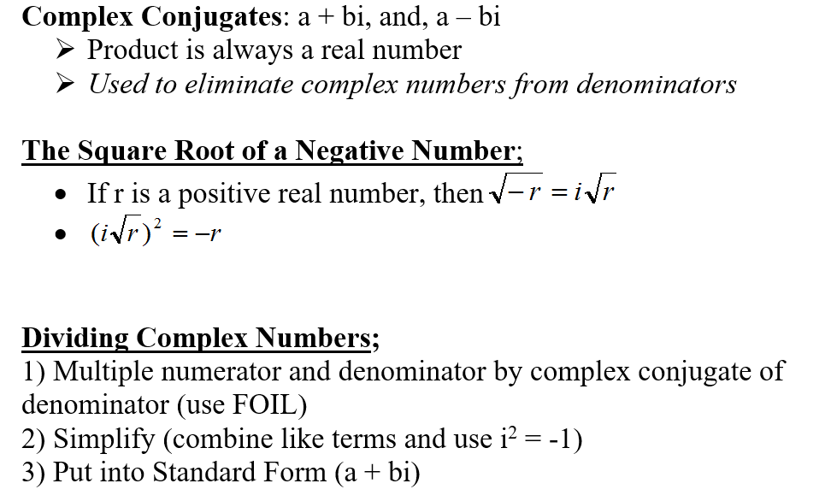
Additional Info on Complex Numbers

Slide 16
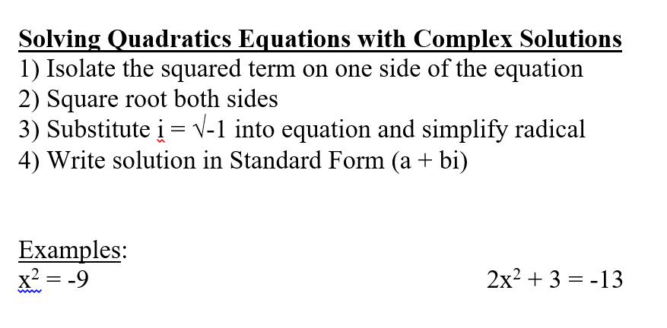
Additional Info on Complex Numbers

